Slide 1
GeoCost - assessment of groundworks and foundation reinforcement costs for buildings
Mats Öberg/Jim Hedfors
GIS Development, SGI
ESRI User Conference, San Diego, July 12, 2017
(3:15 PM - 4:30 PM; Paper #: 86, Room 24 A)

Slide 2
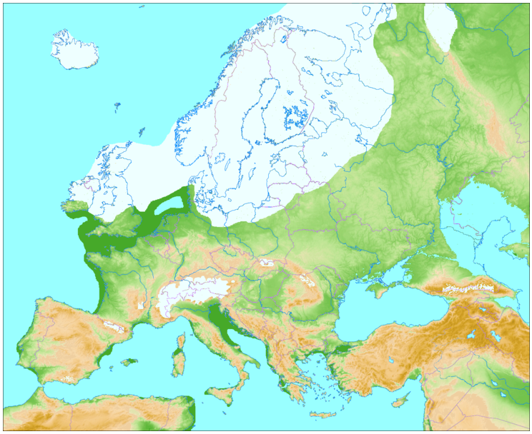
SGI is a government agency and research institute.
Mission to reduce the risks of landslides and erosion
Sweden, covered by ice ~20.000 years ago…
S W E D E N
http://www.geus.dk/viden_om/voii/ilulissat-uk/voii03-uk.html
https://commons.wikimedia.org/wiki/File:Weichsel-W%C3%BCrm-Glaciation.png#/media/File:Weichsel-W%C3%BCrm-Glaciation.png
This has shaped soil formation of Scandinavia, Canada etc - important for foundation reinforcement methods

Slide 3
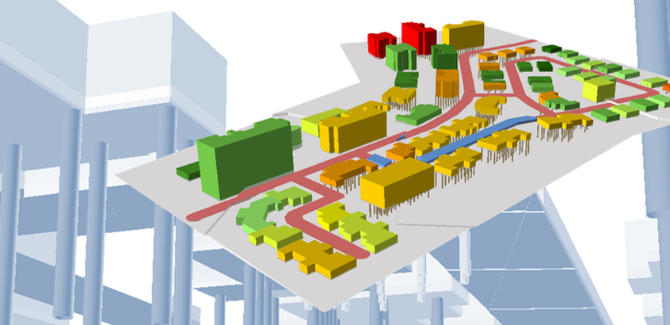
What is GeoCost?
An ArcGIS-based tool (Models) for estimating foundation reinforce-ment costs in municipal develop-ment (and infrastructure*)
GIS + Geotechnical engineer
http://www.swedgeo.se/geokalkyl/
Large savings can be made by placing constructions in areas with the most favorable geotechnical conditions.
Quickly calculates (alternative) costs for cut/fill, foundation reinforcement etc. Detailed elevation and soil data is used.
Financed by the Swedish Government
*) Also used by Swedish Transport Administration

Slide 4
Illustration of foundation reinforcement cost per m² and suggested reinforcement method
Also summaries of TOTAL cost and TOTAL cut/fill volumes

Slide 5
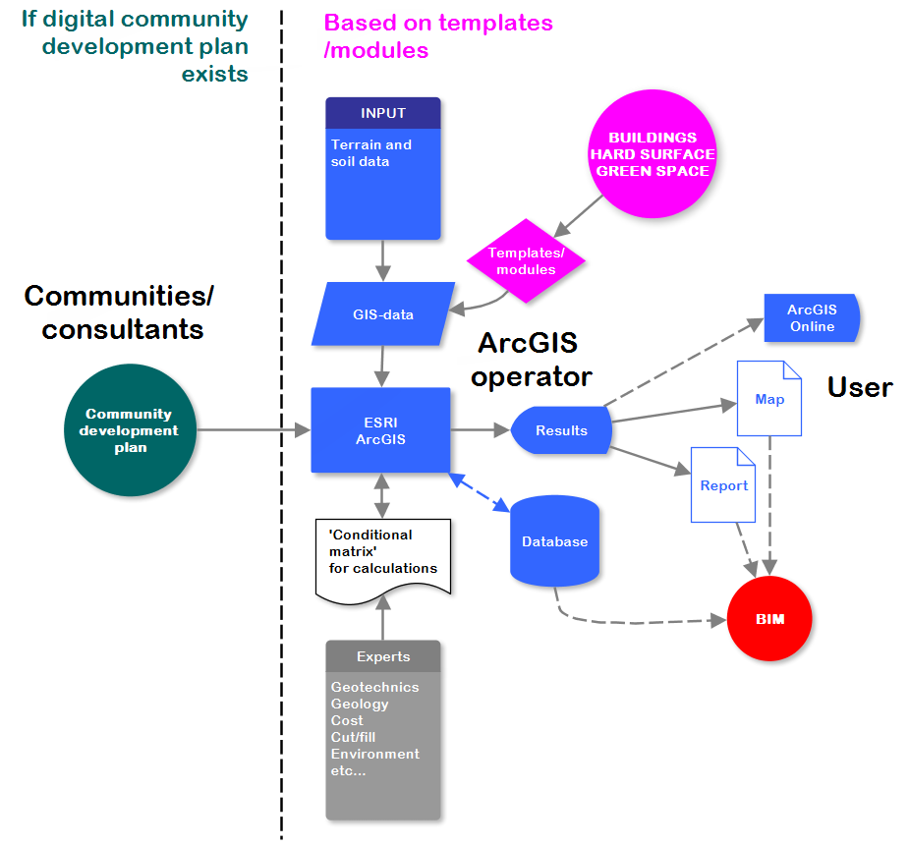
System workflow
GIS
Geoteknik
Geotechics
Skills requirements:
ArcGIS operator
Geotechnical engineer
Software requirements:
ArcGIS Desktop 10.2+
3D-analyst
Microsoft Excel 2010+

Slide 6
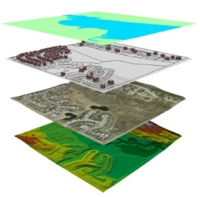
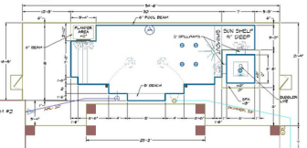
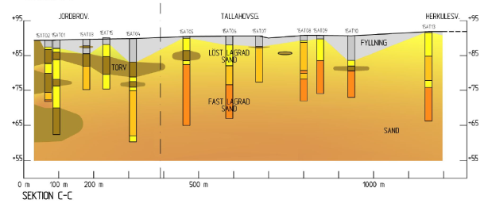
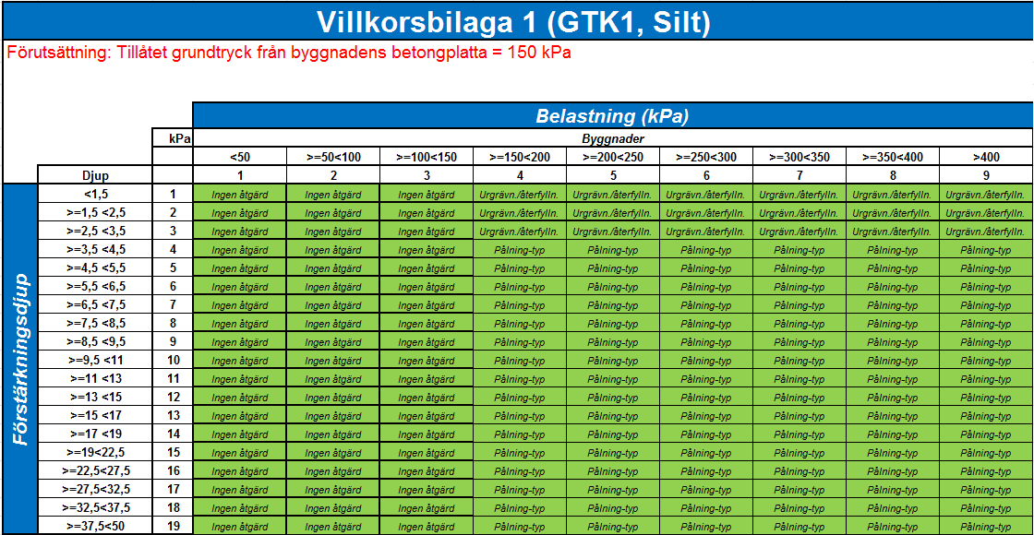
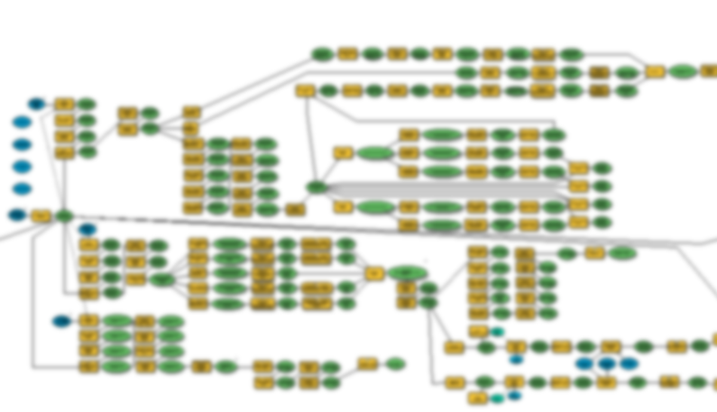
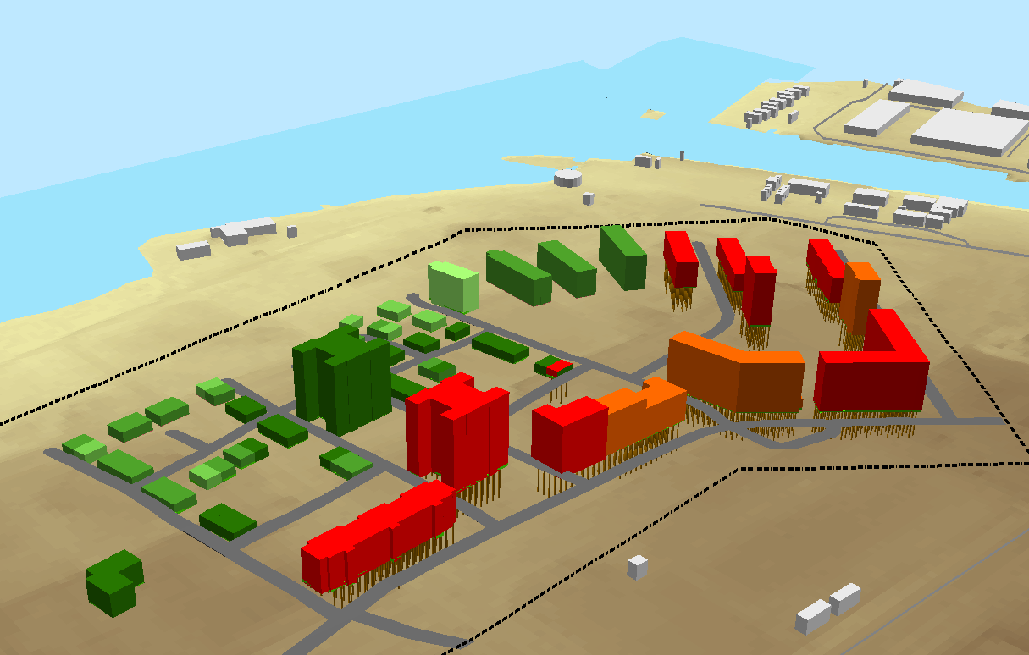
Prepare input data
1) Buildings (incl. height etc), 2) Hard surfaces (road etc), 3) Green space (vegetation)
Terrain data (e.g. 2m raster); Soil geology
Calculate foundation depth & cut/fill volumes
Based on ”Geotechnical Terrain Class” classification (soil profile down to bedrock)
Geoteknik
GIS
Calculate foundation reinforcement methods (piles etc)
Based on Excel ’conditional matrix’ created by geotechnical engineering practise (reinforcement metod etc, distance between piles etc), calculated using a series of ArcGIS Models
Geotechics
Calculate costs/
generate 3D scene
Based on Excel ’condition matrix’, calculated using a series of ArcGIS Models

Slide 7
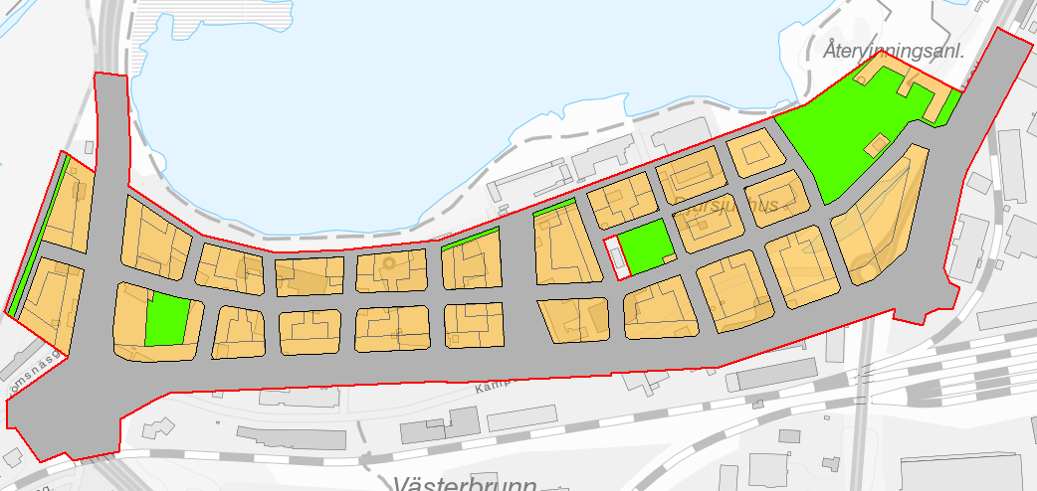
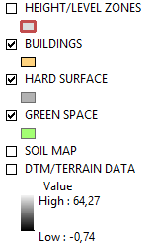
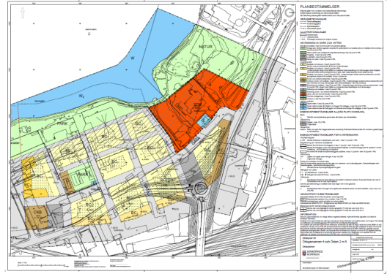
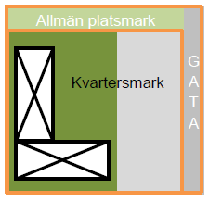
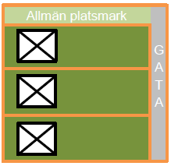
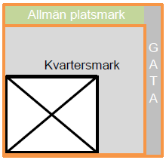
A development plan (’ready stage’) OR
modules of building blocks (’early stage’)
Type 1
Type 2
Type 3
Green space
50m
Buildings
Hard surface
50m

Slide 8
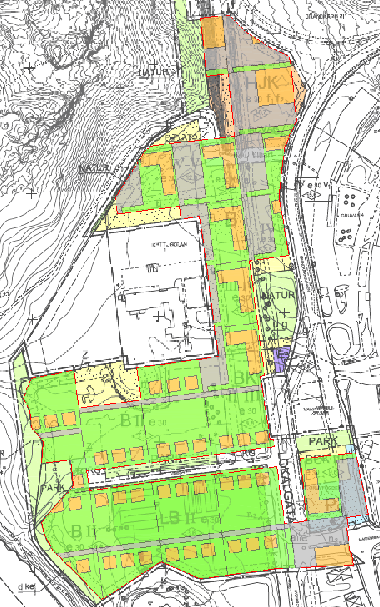
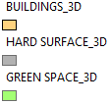
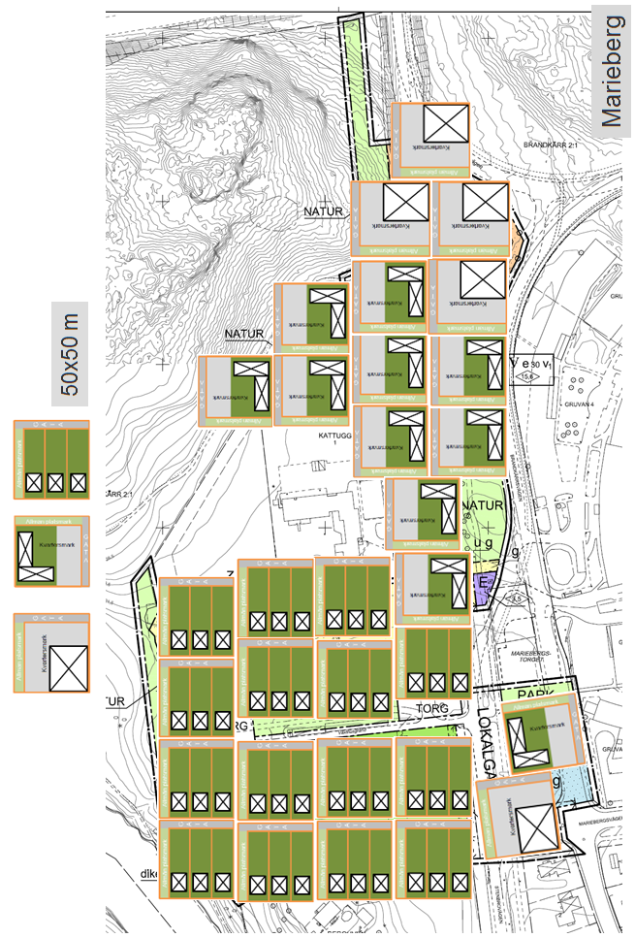
Example of placement of modules and making consistent GIS-surfaces
*) consistent = adjacent, non-overlapping buildings; hard surfaces; green space

Slide 9
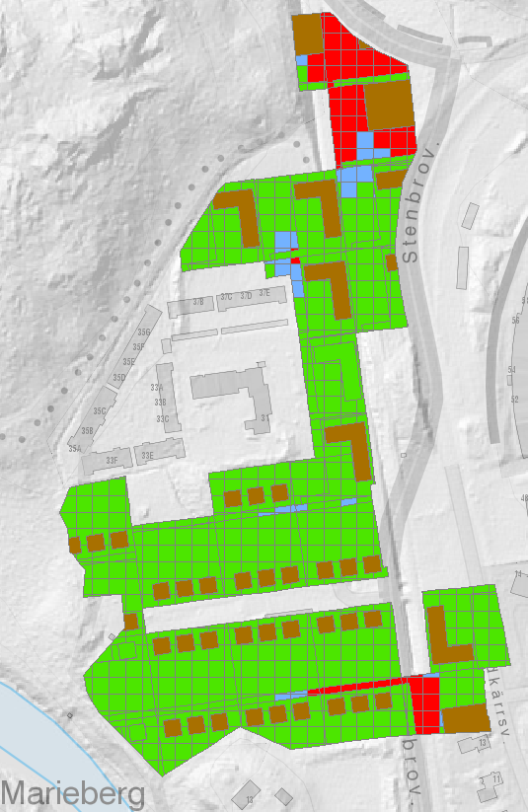
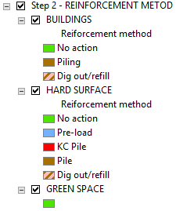
Suggested reinforcement method

Slide 10
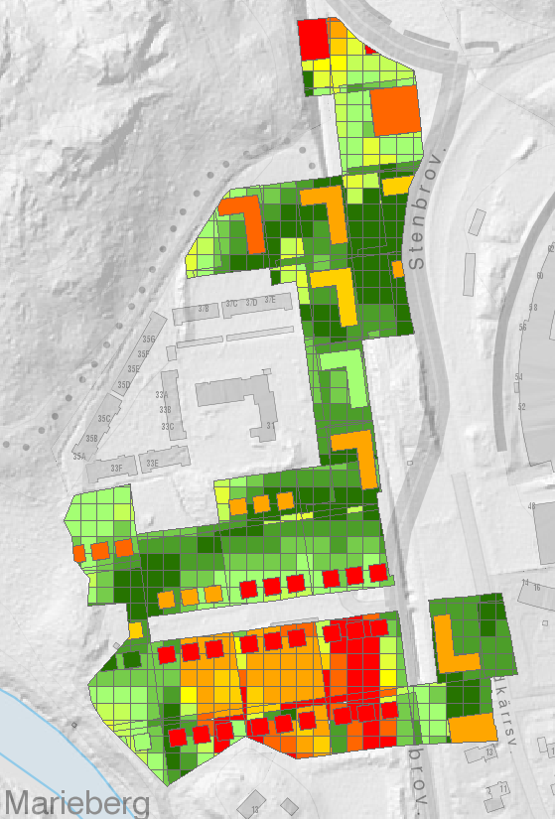
Cost (for reinforcement) in Swedish Krona/m2 [2D display]
E.g. 1000 SEK ~ 100 US$

Slide 11
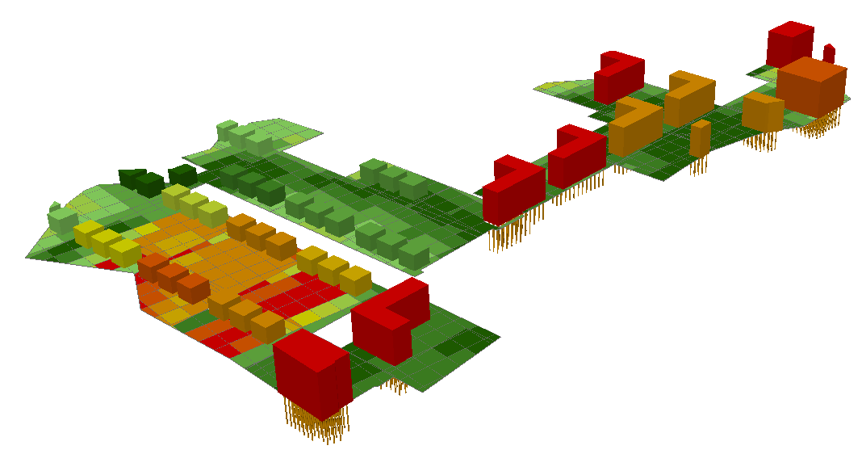
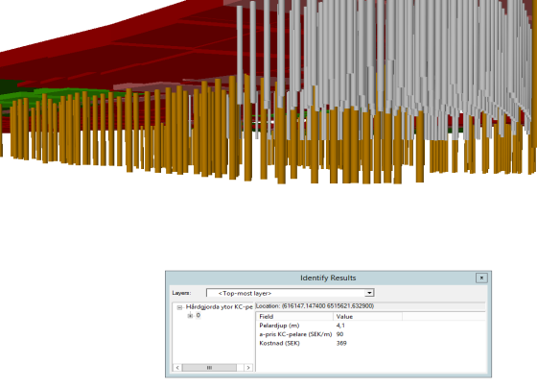
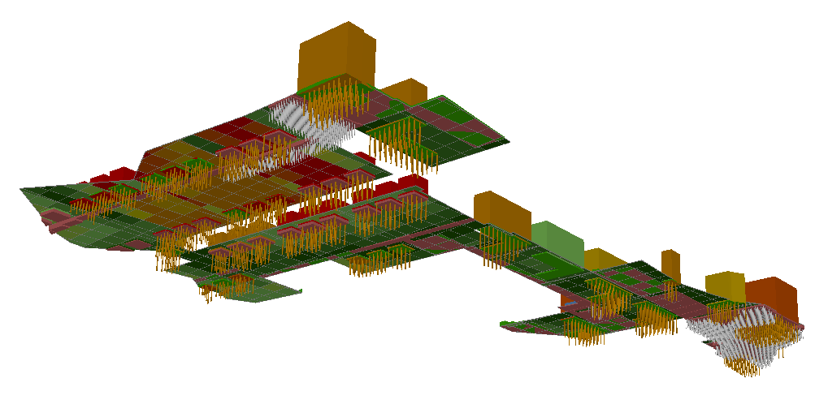
Cost (for reinforcement) in Swedish Krona/m2 [3D display in ArcScene]
Steel, concrete or lime cement piles
xls summary of TOTAL costs (tSEK)
Cut/fill
Reinforcement
Toxic cleanup
TOTAL
~ 2 million US$
xls summary of cut/fill volumes (m3)
Cut
Fill
Exaggerated height scale 1,5X

Slide 12
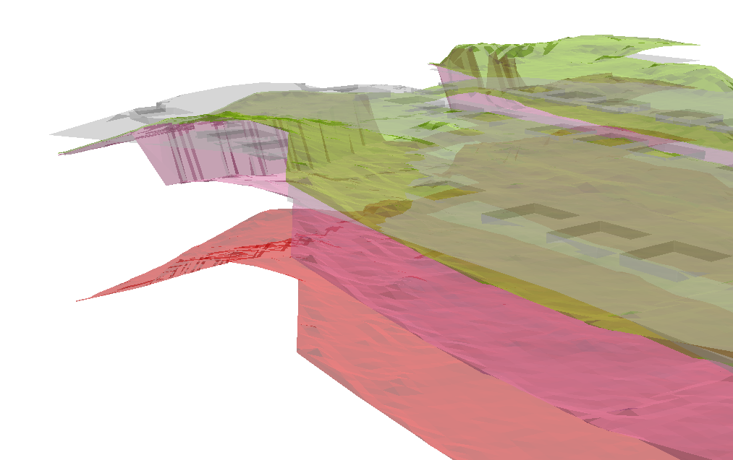
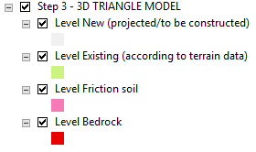
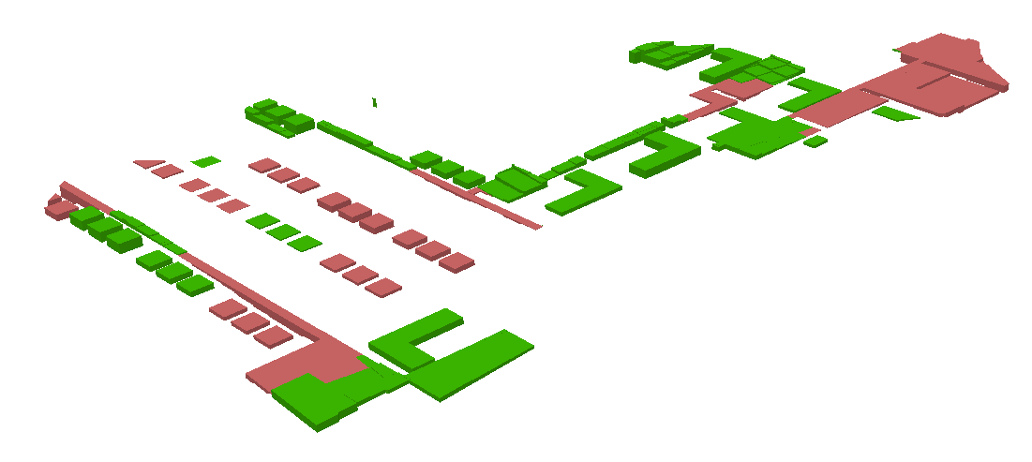
3D, top surfaces for various levels
Cut and fill [3D display]
GeoCost allows for zoning of height areas

Slide 13
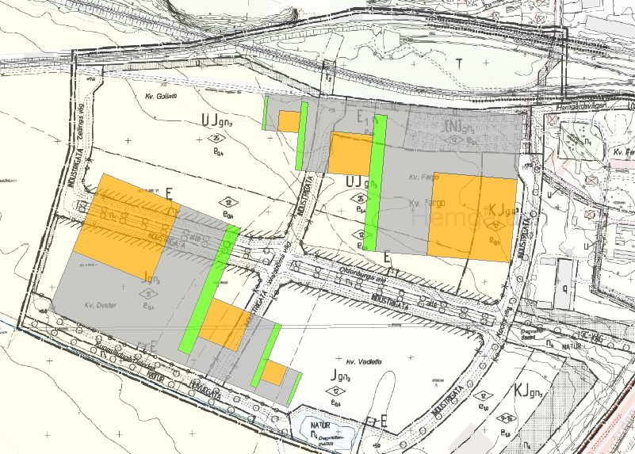
Two alternative locations for the same set of buildings…
TOTAL:
4 million US$
Hemgården NO
Höjdzon: +8,4 m.ö.h.
TOTAL:
2 million US$
Important calculation results:
Reinforcement costs in the Northeast would be double compared to the reinforcement cost if construcion would occur in Southwest.
Hemgården SV
Höjdzon: +5,9 m.ö.h.

Slide 14
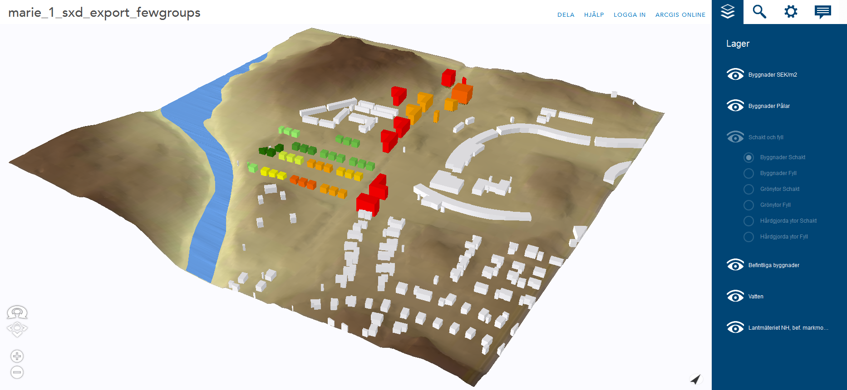
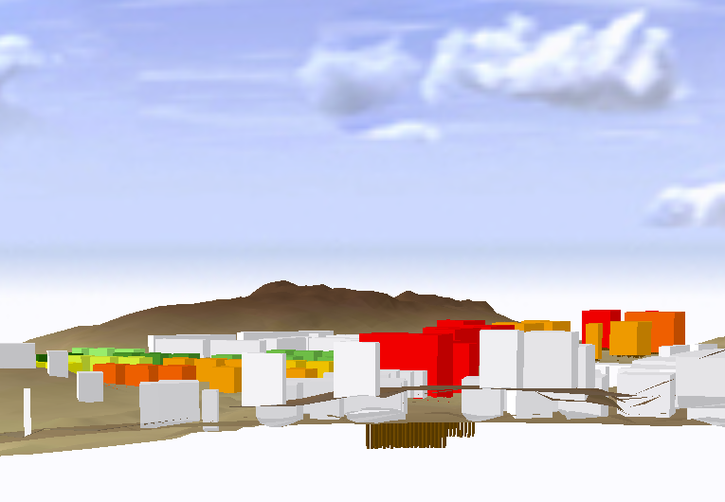
3D web display (with surrounding terrain and existing buildings) – ArcGIS Online/City Engine
https://gis.swedgeo.se/geokalkyl/3ws/
The tool (mxd, tbx, sxd, example data, Manual, instruction videos) is free to download at
http://gis.swedgeo.se/geokalkyl/verktyget
(in Swedish…)

Slide 15
Thank you!
CONTACT
Mats Öberg (GIS-architect, M.Sc. Civil Engineering) Swedish Geotechnical Institute Hugo Grauers gata 5 B 412 96 GOTEBORG Phone: +46 709 730 129
E-mail: mats.oberg@swedgeo.se

Slide 16
EXTRA

Slide 17
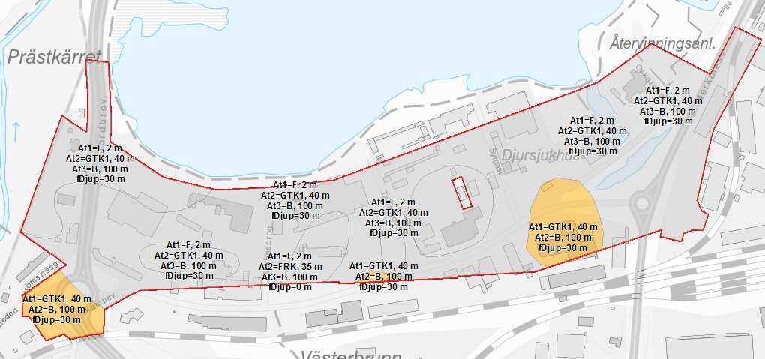
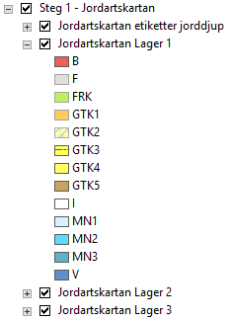
GTK Geotechnical Terrain Class must be evaluated by geotechnical engineer
The soil profile to bedrock may vary considerably!

Slide 18
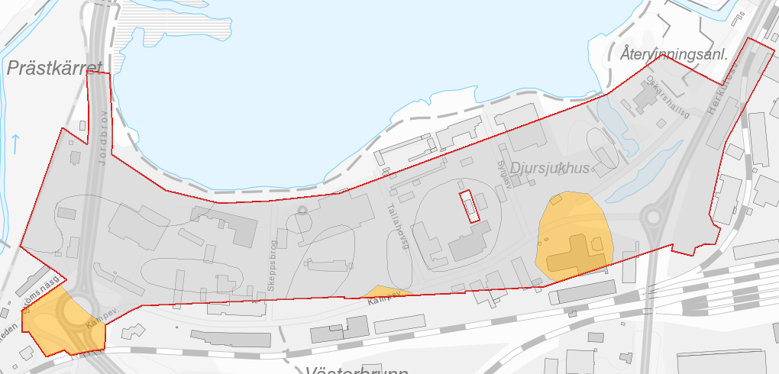
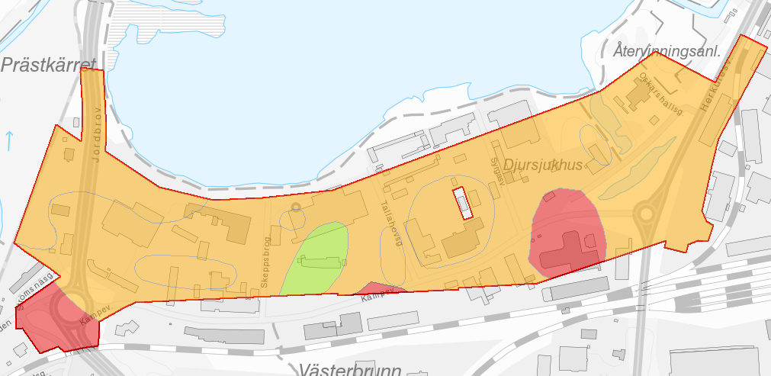
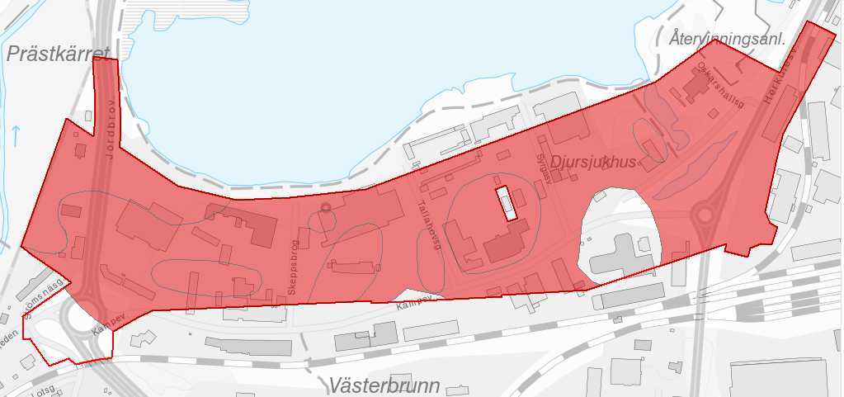
Soil layer 1
Soil layer 2
Soil layer 3

Slide 19
Item attributes may be shown

Slide 20
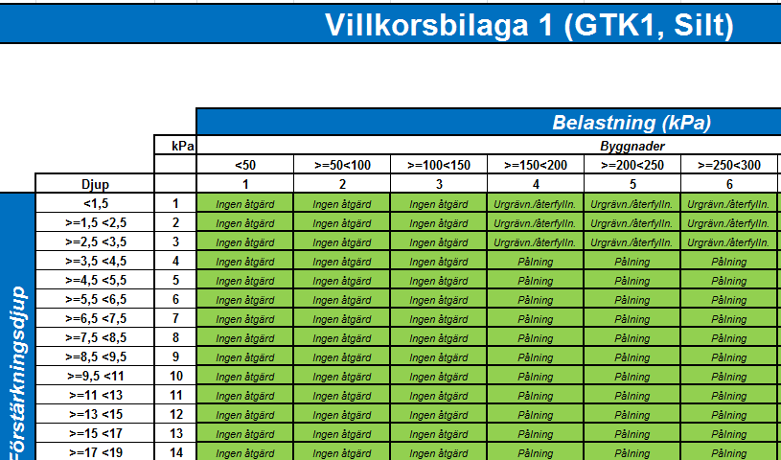
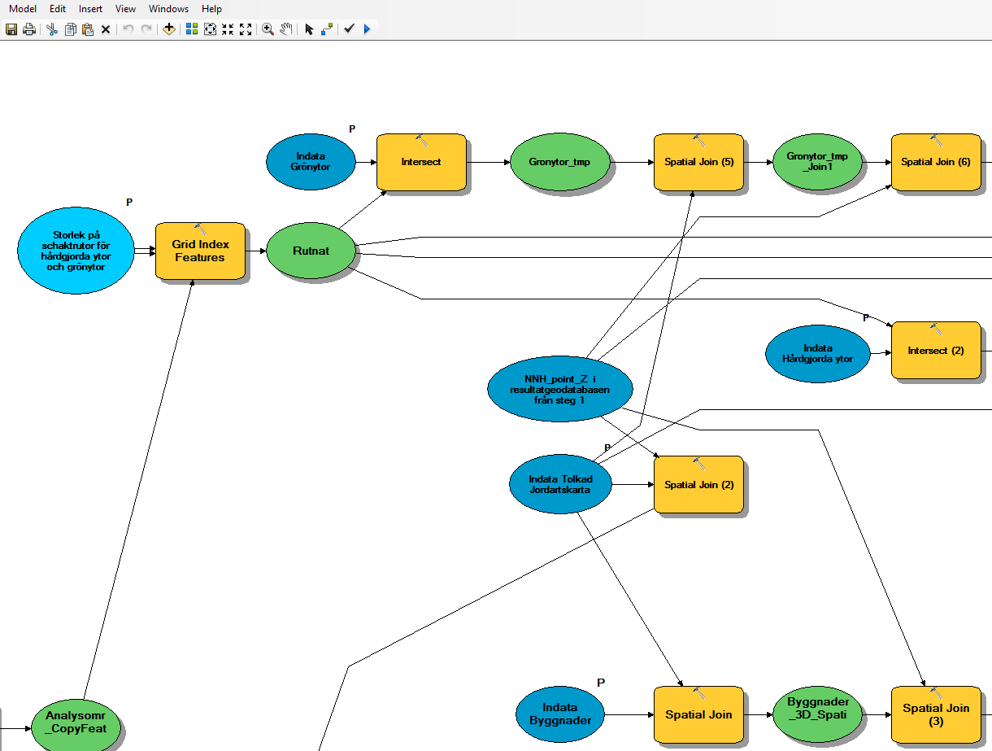
Conditional matrix
A specific Geotechnical Terrain class
Load in kPa of a building
Various reinforcement metods applied
Reinforcement
depth
A small part of one of the Models
Developed by

